Slide 1
Intro to Networks
UT LAW 379M
Spring 2021
Lecture Notes

Slide 2
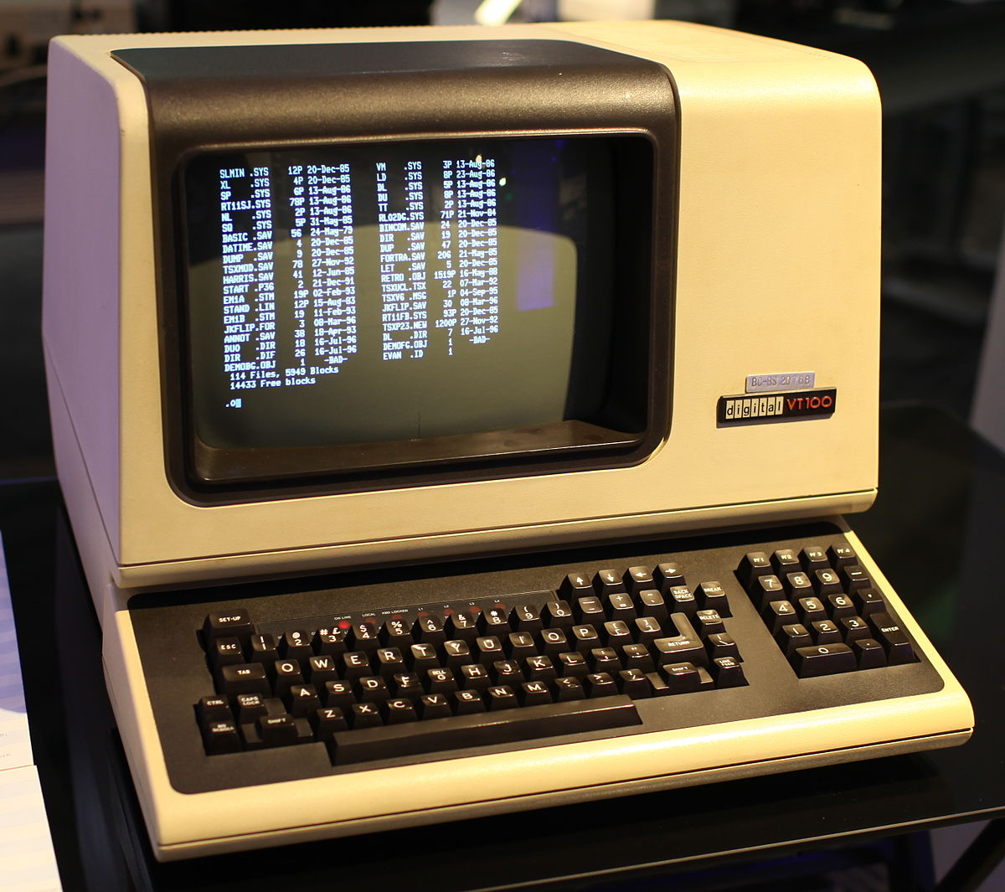

Computing 1960-1980 (ish)
NETWORK
This Photo by Unknown Author is licensed under CC BY-SA-NC
“DUMB” TERMINAL
MAINFRAME
Basically, just a keyboard and monitor
All the processing (computer brains) happens here
This Photo by Unknown Author is licensed under CC BY-SA

Slide 3
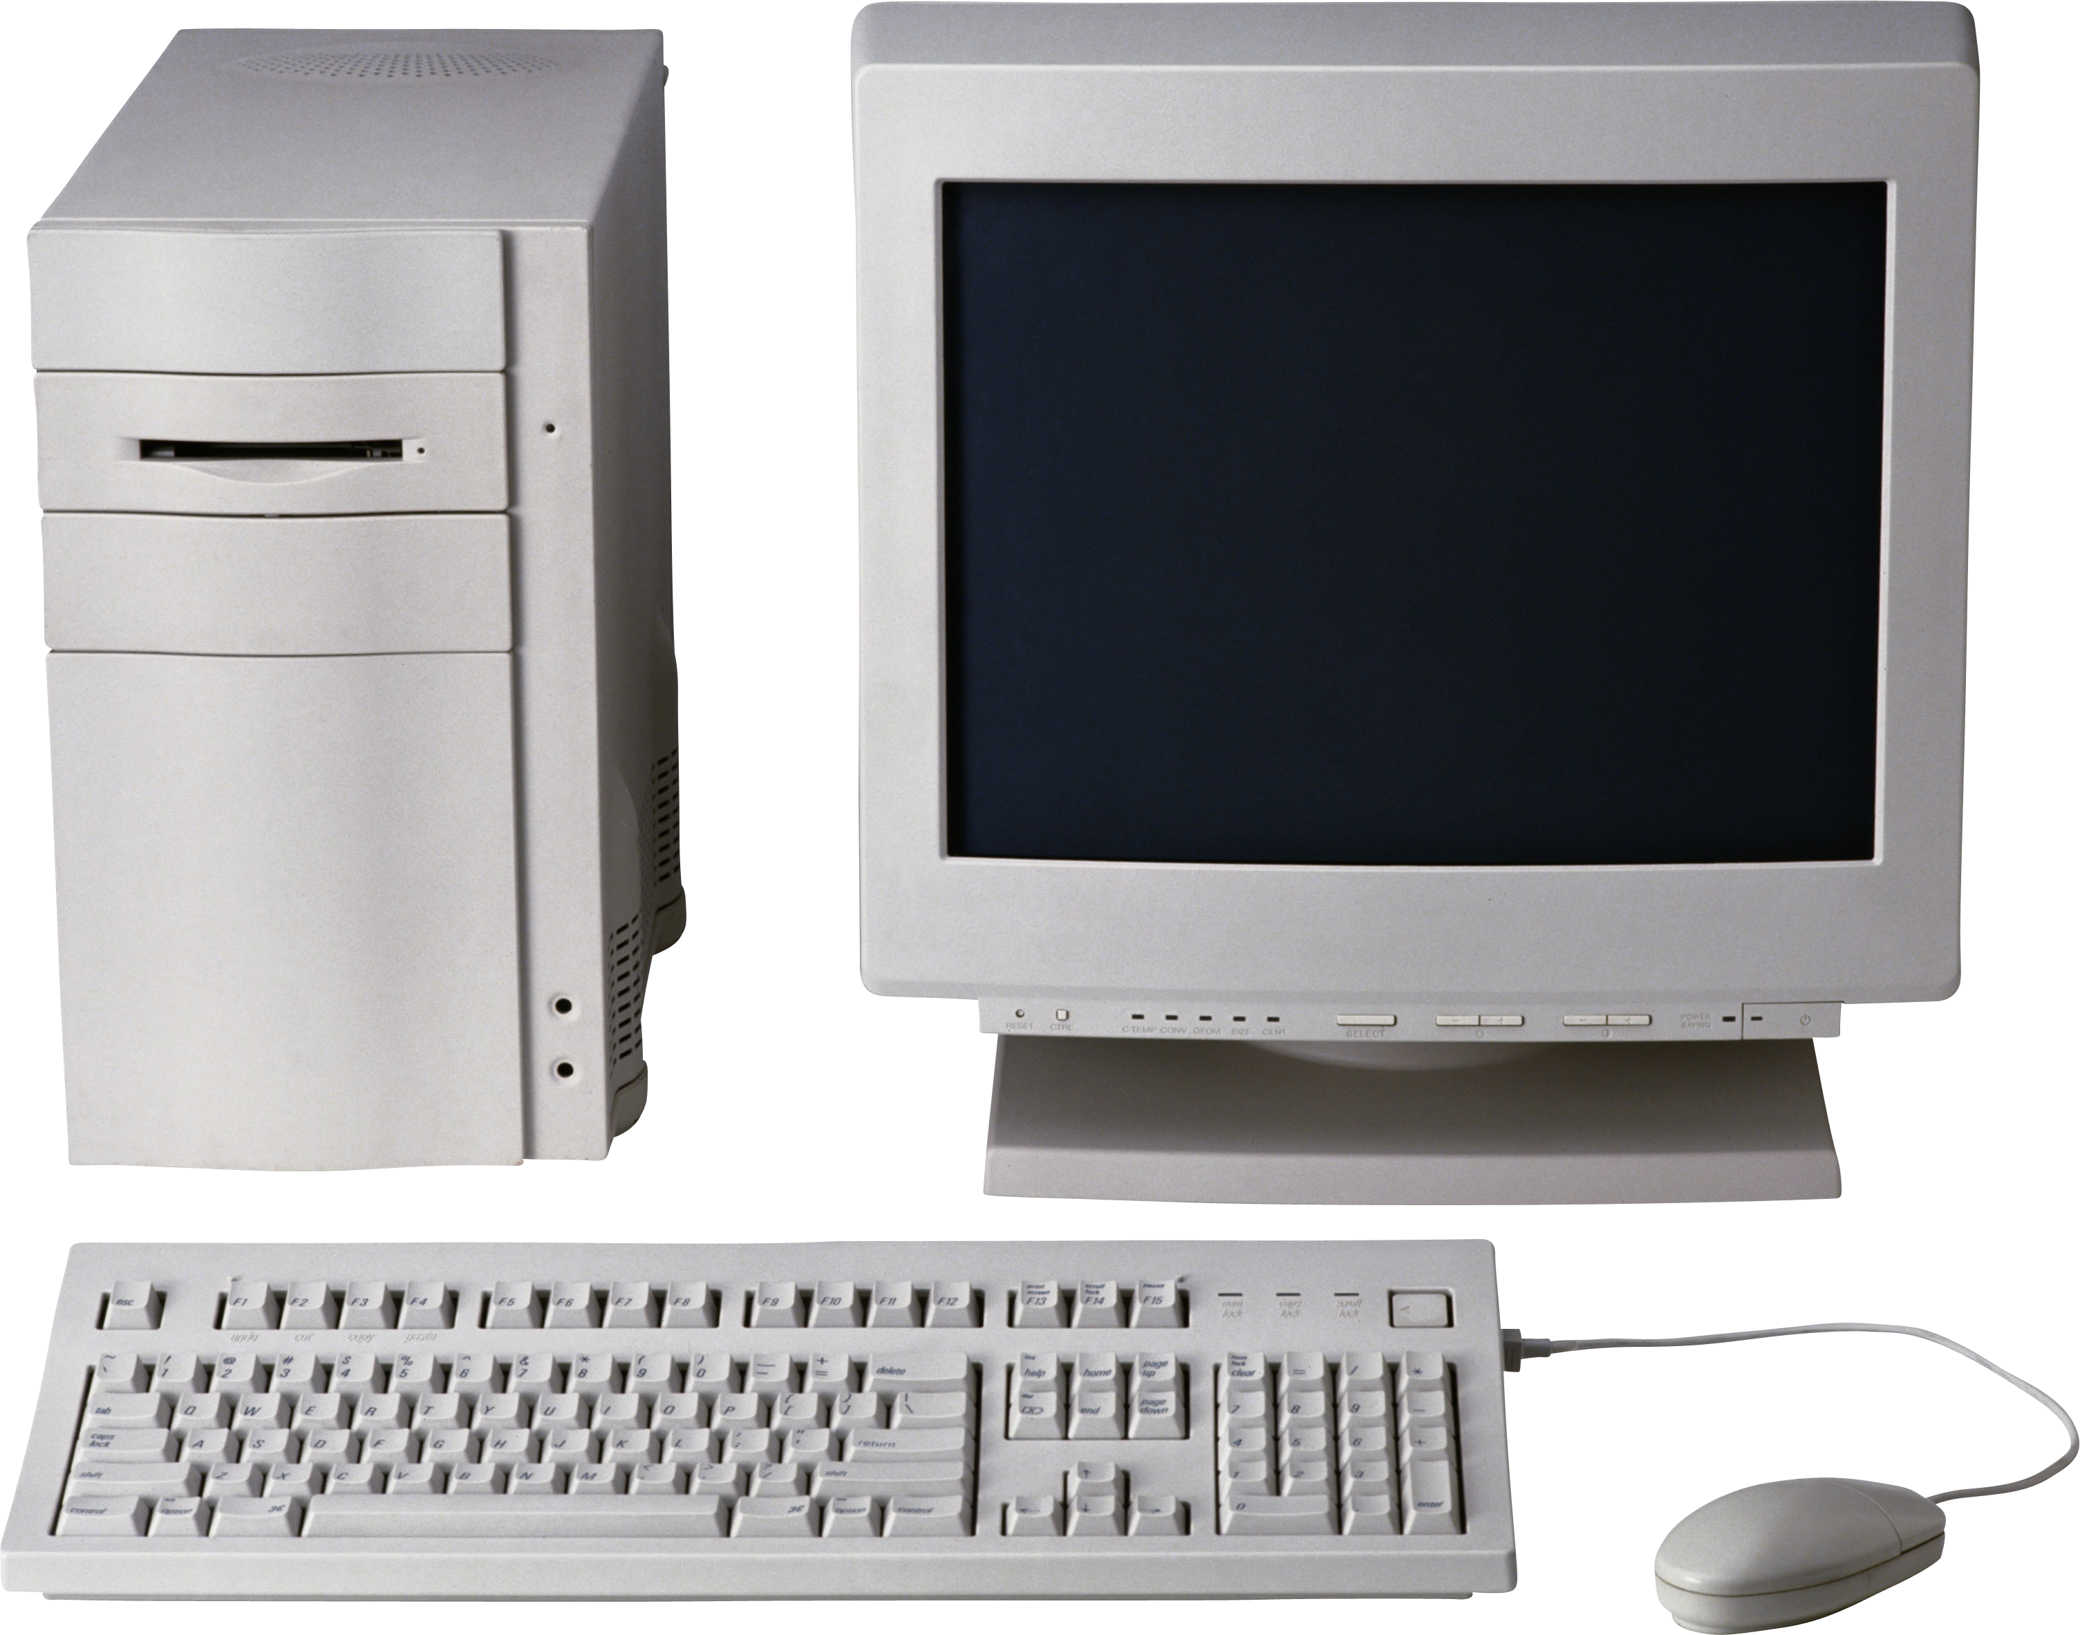
Computing 1980-2000 (ish)
For the most part, NO NETWORKING
This Photo by Unknown Author is licensed under CC BY-NC

Slide 4
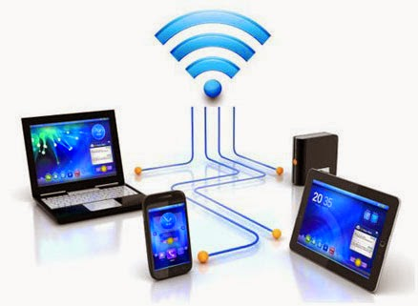
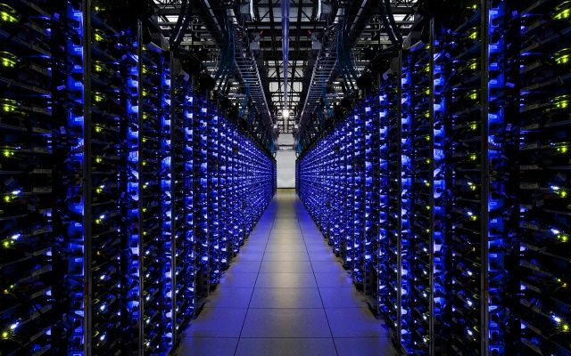
Computing 2000 – Present
NETWORK
This Photo by Unknown Author is licensed under CC BY
This Photo by Unknown Author is licensed under CC BY-NC-ND

Slide 5
General Ideas Behind Client-server
Put a bunch of resources in a high-performance, centralized machine (SERVER)
Clients can be much “dumber” by comparison
Much more efficient
Sharing data between devices, applications, and people (and marketing)
Access from multiple locations (including hackers!)
Time-sharing a central machine is more scalable and cost-effective

Slide 6
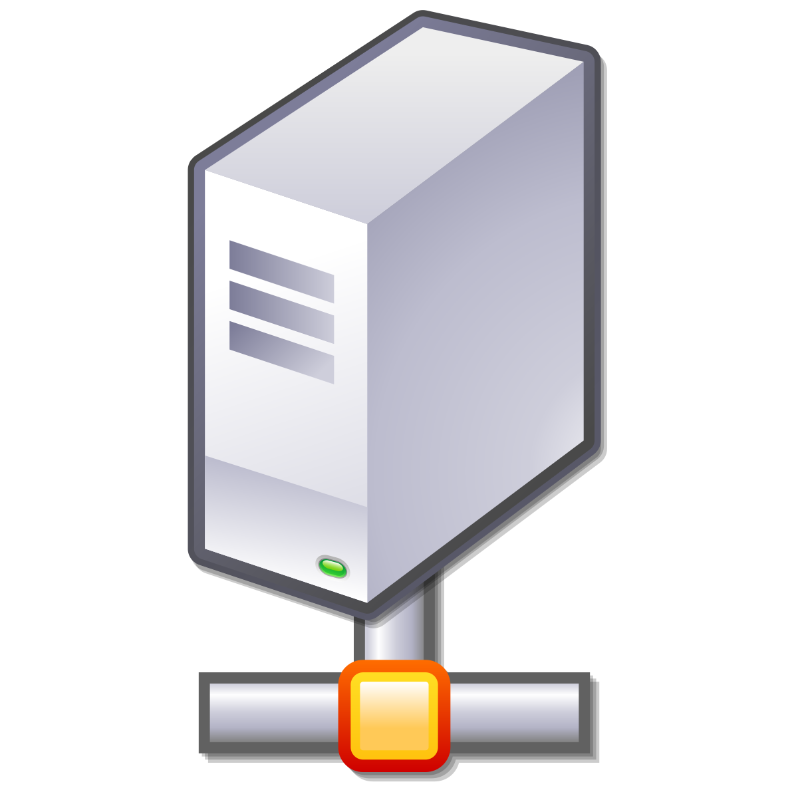
Confusing Meaning of “Server”
Server sometimes refers to the actual physical machine
Server sometimes refers to the computer program that provides service
A machine is a “server” if it has 1+ server programs running
Web Server
Program
Game Server
Program
This Photo by Unknown Author is licensed under CC BY-SA

Slide 7
Server Abstraction
I’m Lonely. I wish someone would talk to me!
This Photo by Unknown Author is licensed under CC BY-SA
SERVER (Program) LISTENS FOR INCOMING REQUESTS

Slide 8
Addresses Needed
The server can’t receive a request without an “address”
Typically identify machines with an Internet Protocol (IP) address
Typically identify programs on the machine with a “port”
TCP ports are for guaranteed delivery, like for file transfer (most common)
UDP ports are for best-effort delivery, like streaming music or games

Slide 9
Addresses and Ports
Address is kind of like the address of a building
Port is kind of like the apartment number

Slide 10
IP (Version 4) Address
Although IP Version 6 addresses are in use…
IP Version 4 addresses are still pretty common
172.217.1.142
Type this in your browser!
Four numbers between 0 and 255
(separated by “.”)

Slide 11
Ports Allow Multiple Servers
80 – Unencrypted web traffic
443 – Encrypted web traffic
25 – Email data tranfer

Slide 12

Assigning an Address and Port
Now I have an Address/Port! Maybe I’ll get Requests!
IP: 192.168.0.1
PORT: 80
This Photo by Unknown Author is licensed under CC BY-NC
This Photo by Unknown Author is licensed under CC BY-SA
SERVER HAS AN IP ADDRESS AND TCP PORT

Slide 13
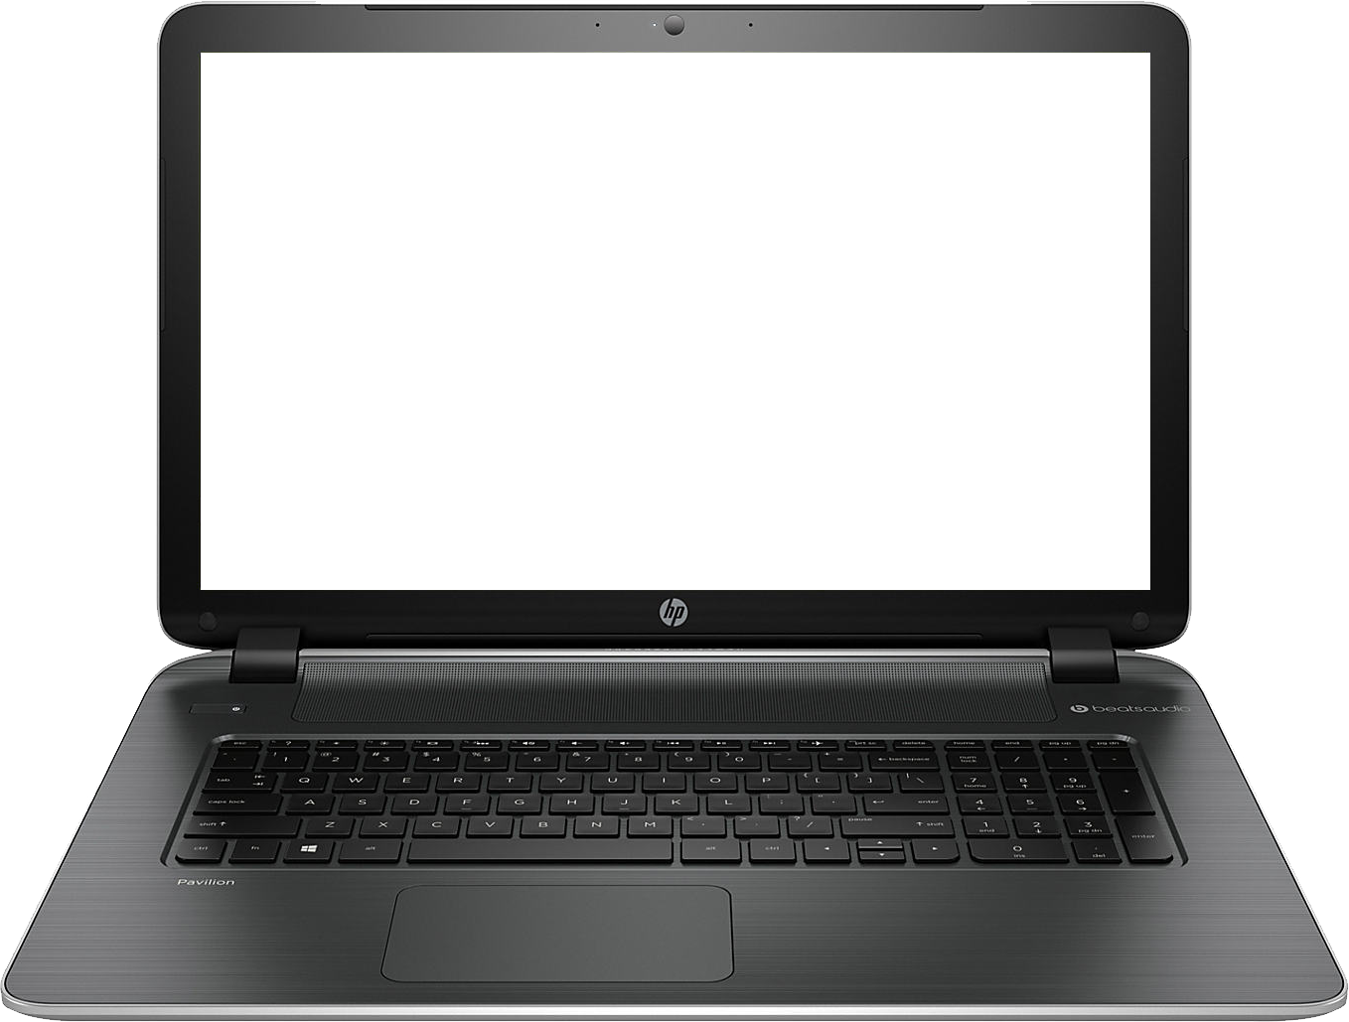
Meanwhile, Client Abstraction
HELLO?!
This Photo by Unknown Author is licensed under CC BY-NC
CLIENT (program) CONNECTS TO MAKE OUTBOUND REQUESTS

Slide 14

Client (program) Needs Return Address
HELLO?!
TO: 192.168.0.1:80
FROM: 192.168.0.2:5280
Usually arbitrary, picked
by operating system
This Photo by Unknown Author is licensed under CC BY-NC
This Photo by Unknown Author is licensed under CC BY-NC
CLIENT (program) CONNECTS TO MAKE OUTBOUND REQUESTS

Slide 15
Incoming Request
I GOT A REQUEST!!!
REQUEST
TO: 192.168.0.1:80
FROM: 192.168.0.2:5280
This Photo by Unknown Author is licensed under CC BY-SA
SERVER RECEIVES REQUEST

Slide 16
Request Response
MY NEW PENPAL!
RESPONSE
TO: 192.168.0.2:5280 FROM: 192.168.0.1:80
This Photo by Unknown Author is licensed under CC BY-SA
SERVER INVERTS TO/FROM FOR RESPONSE

Slide 17
What is a Protocol?
A protocol is the set of rules that govern the interaction of two or more parties
In the context of networking, it defines how two nodes (like client and server) communicate
When a party can communicate
What a party can communicate, including message structure
How a party responds to received communications
Certain outcomes or results are guaranteed when the rules are followed

Slide 18
Overloaded Term
Actually, a protocol often refers to two separate things
FIRST, the rules/specification referred to on the previous slide
SECOND, the computer module that implements the rules

Slide 19
Common Contemporary Protocols
HTTP – HyperText Transfer Protocol
IP – Internet Protocol
SMTP – Simple Mail Transport Protocol

Slide 20
One Protocol is not Enough
There are too many rules for any one protocol to handle
Also, behavior/rules need to change for different hardware/goals
OSI defined a conceptual “stack” of protocols.
Each protocol “layer” can push data down to a lower layer, or pop data up to a higher layer
The protocol on one machine (e.g., client) is a “peer” with the same protocol on the other machine

Slide 21
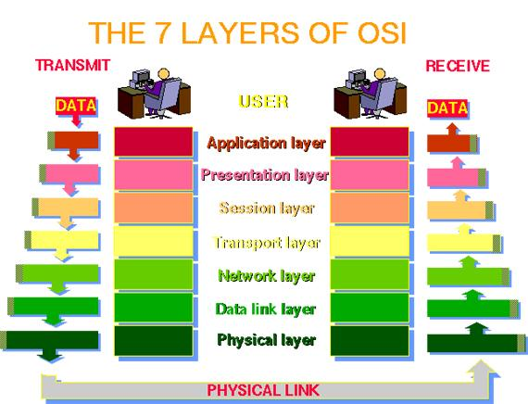

Slide 22
The OSI Model in Practice
Very few systems follow the seven-layer “ideal”
Mostly just care about TCP/IP and the following layers:
Application (Layer 7; example: HTTP)
Transport (Layer 4; TCP)
IP (Layer 3; IP)
Data Link (Layer 2; example: Ethernet or Wifi)
NOTE: It’s common to just refer to a layer by it’s number (e.g., a layer-4 protocol)

Slide 23
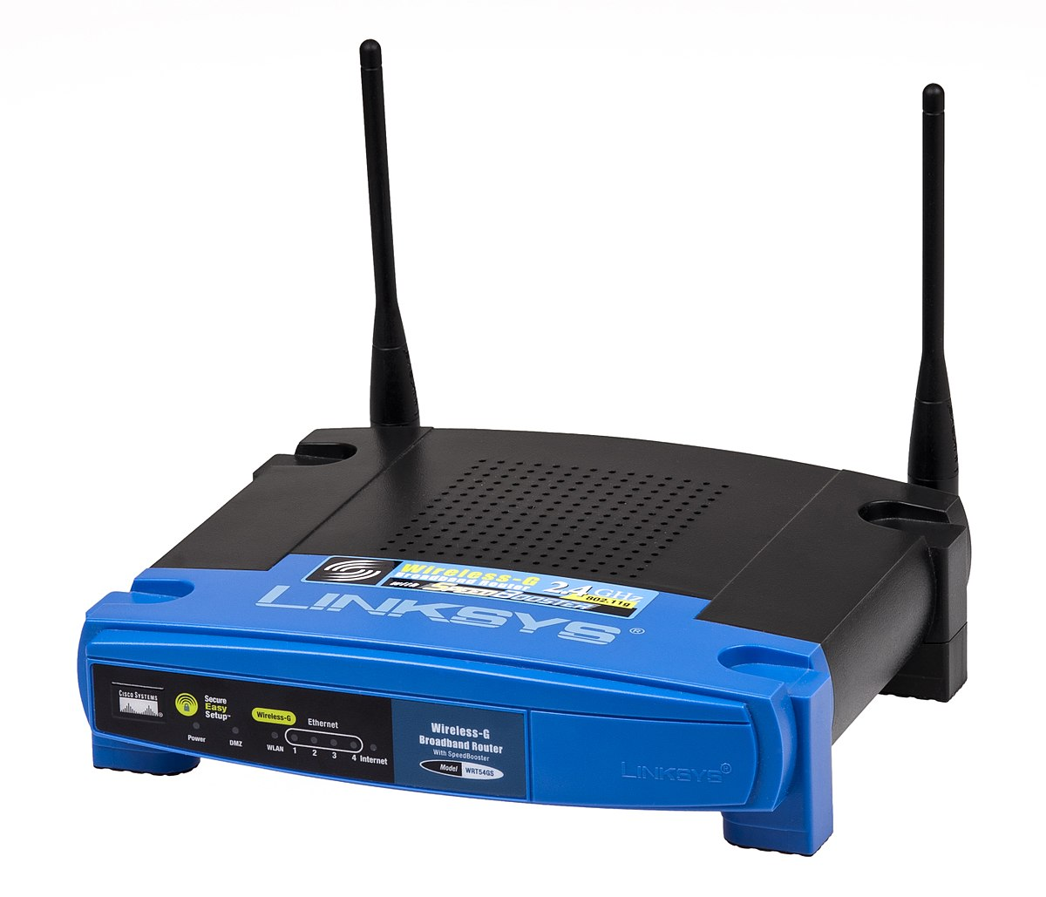
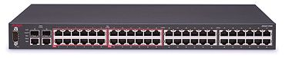
Monolithic vs Modular
HTTP Monolith Ethernet
HTTP Monolith
Wifi
HTTP
TCP
UDP
IP
Ethernet
WiFi
This Photo by Unknown Author is licensed under CC BY-SA
This Photo by Unknown Author is licensed under CC BY-SA

Slide 24
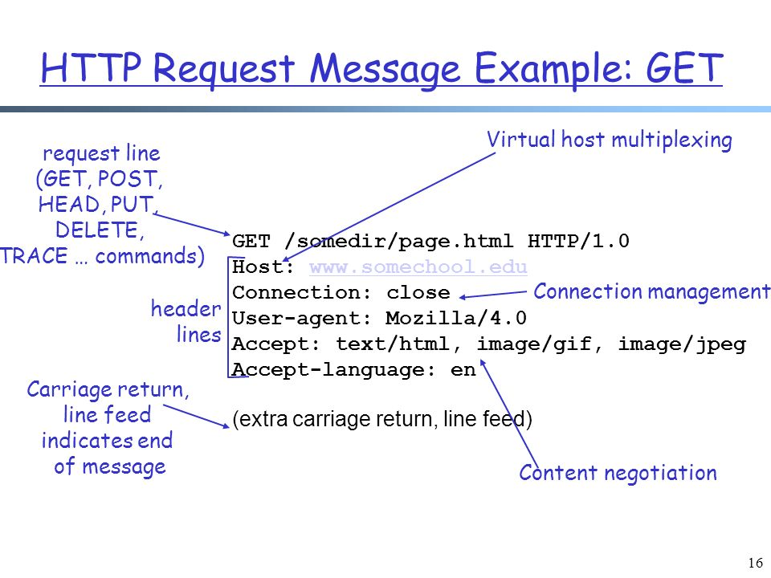
HTTP Request

Slide 25
TCP/IP Send Example
User enters “google.com” into browser
(computer converts “google.com” to an
IP address first).
HTTP is the protocol used for sending/receiving data to/from websites.
TCP deals with making sure the data gets to the right server program correctly
IP is used for getting data over the Internet to the correct machine
MAC is used for communicating on Wifi or Ethernet
HTTP
HTTP Request
TCP
TCP
HTTP Request
IP
IP
TCP
HTTP Request
MAC
MAC
IP
TCP
HTTP Request
Headers. Typically meta data such as “to”, “from”, etc.

Slide 26
TCP/IP Receive Example
Web server program begins gather the requested info. When it has it, it will respond by sending a new message down the stack in the reverse direction
As each layer processes the data, the headers are stripped off. The MAC layer removes the MAC header, the IP layer removes the IP header, etc., before passing the data up. Each layer may or may not need to do some processing based on information in the header.
HTTP Request
HTTP
TCP
HTTP Request
TCP
IP
TCP
HTTP Request
IP
MAC
IP
TCP
HTTP Request
MAC
Conceptually, data arrives at the bottom of the stack
and is processed and then “popped” up to a higher layer

Slide 27
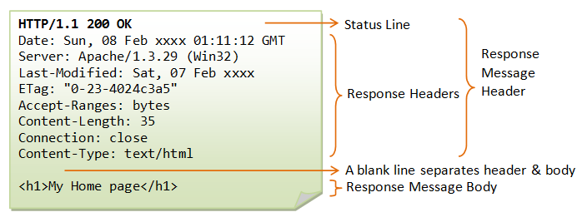
HTTP Response

Slide 28
Wireshark Exercises

